Slide 1

IFT222
Computer Architecture and Organization
Department of Computer and Information Sciences
MEMORY HIERARCHY AND CACHE MEMORY DESIGN

Slide 2
Memory Access Methods
Sequential = A,B, C, D ,E access by sequence one after other (magnetic tape)
Random = A,B, C, D,E = all locations can be accessed at constant time (RAM)
Direct = Street locating the vicinity (Block) A,B, C, D,E (HDD)
Associative = address + content are together = Cache
Computer Memory exhibits a number of xtics
  Location
  Access methods
  Performance ( transfer rate, ……)
  Capacity/size

Slide 3
LEARNING OUTCOMES
By the end of this lecture, students should be able to:
Explain the concept and importance of memory hierarchy
Describe the different levels of memory and their characteristics
Analyze trade-offs between speed, cost, and capacity
Explain the principles and operation of cache memory
Differentiate cache mapping techniques:
  Direct mapping
  Associative mapping
  Set-associative mapping
Evaluate cache performance using key metrics
Solve practical problems involving cache organization

Slide 4
INTRODUCTION
Memory hierarchy is a structured arrangement of different storage types in a computer system, designed to optimize performance and cost.
Memory trade-offs are a sad part of reality
Faster access time, greater cost per bit; faster, the expensive
Greater capacity: slower in terms of access
Smaller cost per bit; slower in terms of access
Slower access time - larger capacity

Slide 5
INTRODUCTION
Design constraints on memory can be summed up by three questions:
How much space?
If memory exists, applications will likely be developed to use it.
How fast – access time?
Best performance achieved when memory keeps up with the processor;
i.e. as the processor execute instructions, memory should minimize pausing / waiting for instructions or operands.
How expensive?
Cost of memory must be reasonable in relationship to other components;

Slide 6
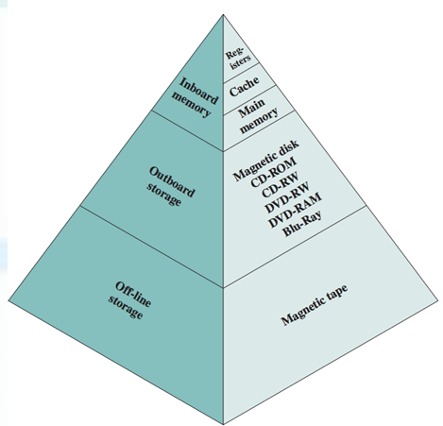
THE WAY OUT
The way out of this dilemma:
Don’t rely on a single memory;
Instead employ a memory hierarchy;
Supplement:
smaller, more expensive, faster memories with larger, cheaper, slower memories;

Slide 7
THE WAY OUT
As one goes down the hierarchy:
Decreasing cost per bit;
Increasing capacity;
Increasing access time;
Decreasing frequency of access of memory by processor – very key to the performance of the CPU

Slide 8
Typical Memory Hierarchy (Top → Bottom)
Level | Memory Type | Speed | Cost | Capacity
1 | Registers | Fastest | Highest | Smallest
2 | Cache Memory | Very Fast | High | Small
3 | Main Memory (RAM) | Moderate | Medium | Medium
4 | Secondary Storage (SSD/HDD) | Slow | Low | Large
5 | Tertiary Storage | Slowest | Lowest | Very Large

Slide 9
Question
Why don’t we use only cache memory in a computer system?

Slide 10
Answer
Because cache is very expensive and has limited capacity.

Slide 11
Strategies to minimize frequent accesses to slower memories

Slide 12
Space and Time locality of reference principle:
Space (Spatial):
If we access a memory location, close by addresses will very likely be accessed; loop operation
Time (Temporal):
If we access a memory location, we will very likely access it again;

Slide 13
Space and Time locality of reference principle:
This a consequence of using iterative loops and subroutines:
Instructions and data will be accessed multiple times;

Slide 14
Example (p1)
Suppose that the processor has access to two levels of memory:
Level 1- L1: contains 1000 words/bytes and has an access time of 0.01µs;
Level 2- L2: contains 100,000/words/bytes and has an access time of 0.1µs.
Assume that:
if word ∈ L1, then the processor accesses it directly = 0.0.1µs;
If word ∈ L2, then word is transferred to L1 and then accessed by the processor. = 0.01 + 0.1

Slide 15
Example(p2)
For simplicity:
ignore time required for processor to determine whether word is in L1 or L2.
Also, let:
• H define the fraction of all memory accesses that are found L1;
• T1 is the access time to L1;
• T2 is the access time to L2

Slide 16
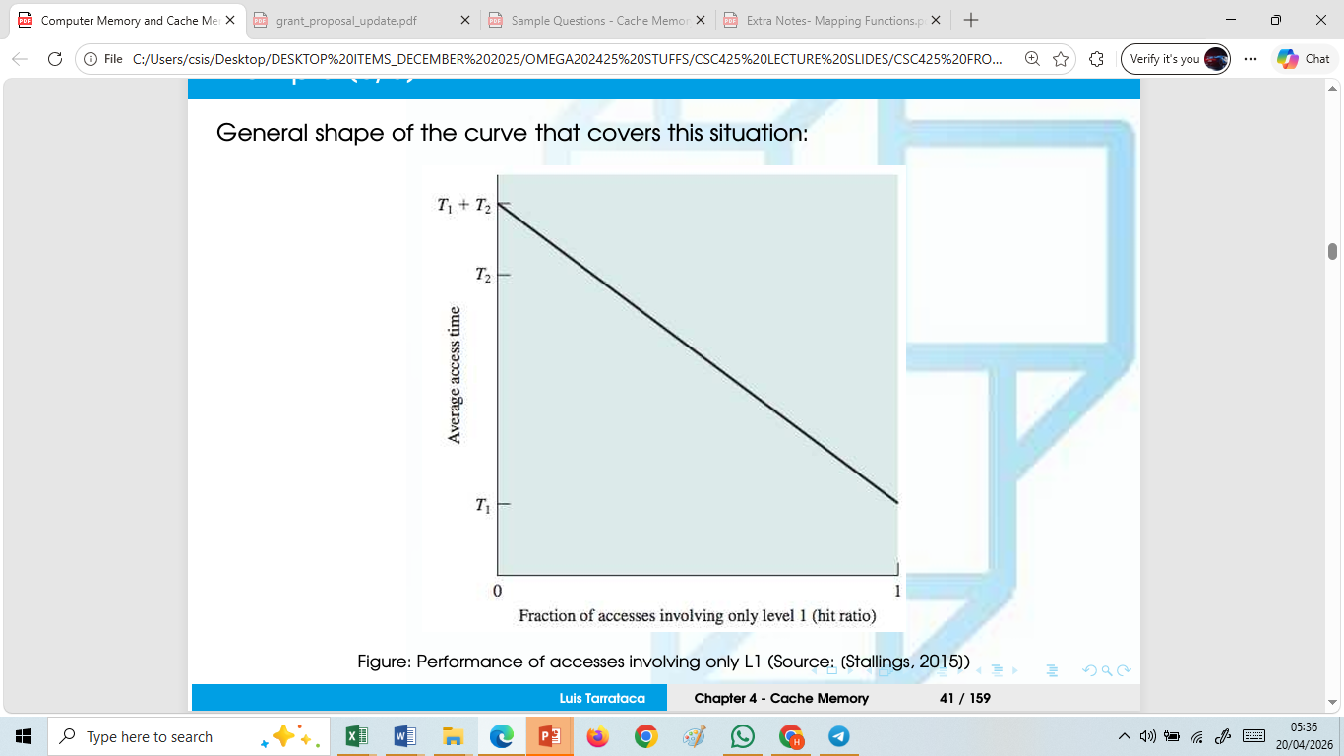
Example(p3)
Figure: Performance of accesses involving only L1

Slide 17
Explanation of the Graph on previous slide
For high percentages of L1 access, the average total access time is much closer to that of L1 than that of L2;
Now lets consider the following scenario:
Suppose 95% of the memory accesses are found in L1 - 0.01µs.
Average time to access a word is:
(0.95)(0.01µs) + (0.05)(0.01µs + 0.1µs) = 0.0095 + 0.0055 = 0.015µs
Average access time is much closer to 0.01µs than to 0.1µs, as desired.

Slide 18
Strategy to minimize accesses should be:
Organize data across the hierarchy such that
% of accesses to lower levels is substantially less than that of upper levels
i.e. L2 memory contains all program instructions and data:
Data that is currently being used should be in L1;
Eventually:
Data ∈ L1 will be swapped to L2 to make room for new data;
On average, most references will be to data contained in L1.

Slide 19
Strategy to minimize accesses…
This principle can be applied across more than two levels of memory:
Processor registers: fastest, smallest, and most expensive type of memory
Followed immediately by the cache: stages data movement between registers and main memory;
Improves performance;
  Is not usually visible to the processor;
  Is not usually visible to the programmer.
Followed by main memory: principal internal memory system of the computer; Each location has a unique address.

Slide 20
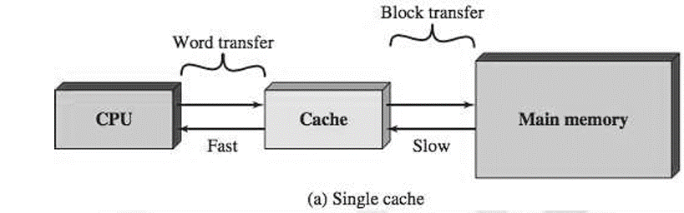
Cache Memory
Cache memory is designed to combine:
Cache can be 1-2 MB while Main Memory can be upto 64GB
Memory access time of expensive, high-speed memory combined with the large memory size of less expensive, lower-speed memory
Cache contains a copy of portions of main memory.

Slide 21
ADDRESS
CELLS
NIBBLE – 4BITS
BYTE – 8BITS
WORD = IS ONE OR MORE COMPLETE ROWS OF MMEMORY = 1 BYTE
BLOCK = A COLLECTION OF WORDS = 2, 4, 8,
BLOCK 0 = 4 WORDS
BLOCK 1 = 4 WORDS
BLOCK 2 = 4 WORDS
10KB
0 | 1 | 2 | 3 | 4 | 5 | 6
7 | 8 | 9 | 10 | 11 | 12 | 13
14 |  |  |  |  |  | 20
21 |  |  |  |  |  | 28
12 x 7 = 84bits/8
memory size = 4MB
4 x 2²⁰
4 x 2¹⁰ x 2¹⁰ bytes
4 x 1024 x 1024 x 8 = 33,554,432 bits
10 x 1024 x 8 = 81,920 bits
10kybe

Slide 22
Cache Memory Principles
When the processor attempts to read a word of memory:
Check is made to determine if the word is in the cache;
  If so (Cache Hit): word is delivered to the processor.
  If the word is not in cache (Cache Miss):
    Block of main memory that contains the word is read into the cache;
    Cache delivers the Word to the processor.
Because of the locality of reference principle (time and space):
  When a block of data is fetched into the cache...
  It is likely that there will be future references to that same memory location

Slide 23
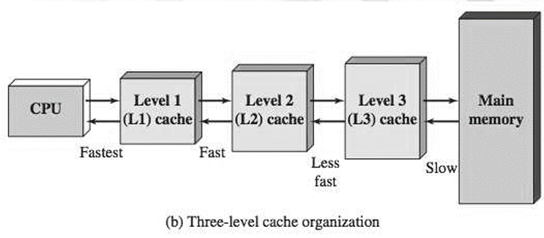
How then can we improve the Cache concept?
What if we introduce multiple levels of cache?
  • L2 cache is slower and typically larger than the L1 cache
  • L3 cache is slower and typically larger than the L2 cache

Slide 24
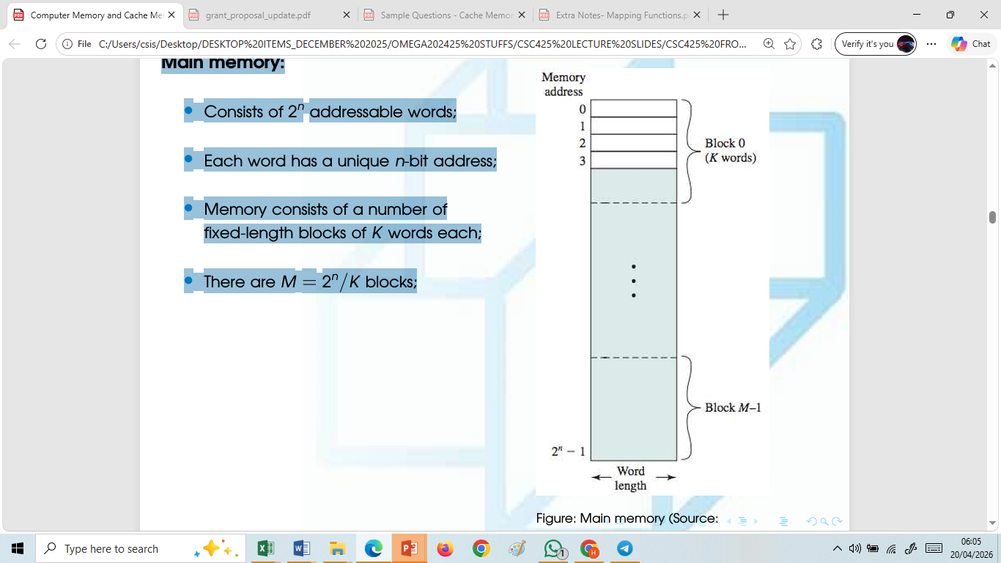
Main Memory – Cache Organization
Main memory:
Cache Memory Principles
  Consists of 2n addressable words;
  Each word has a unique n-bit address;
  Memory consists of a number of
  fixed-length blocks of K words each;
There are M = 2n/K blocks;

Slide 25
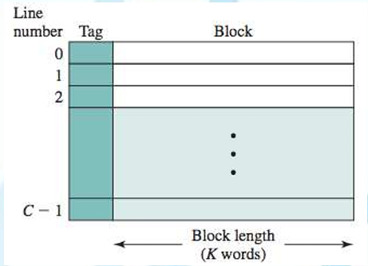
Main Memory –Cache Organization
Cache memory(1/2):
Consisting of m blocks, called lines;
Each line contains K words;
Each line also includes control bits:
  Not shown in the figure;

Slide 26
Main Memory –Cache Organization
Cache memory (2/2):
If a word in a block of memory is read:
  Block is transferred to a cache line;
Because m ≪ M lines:
  Cannot permanently store a block.
  Need to identify the block stored;
    Info stored in the tag field;

Slide 27
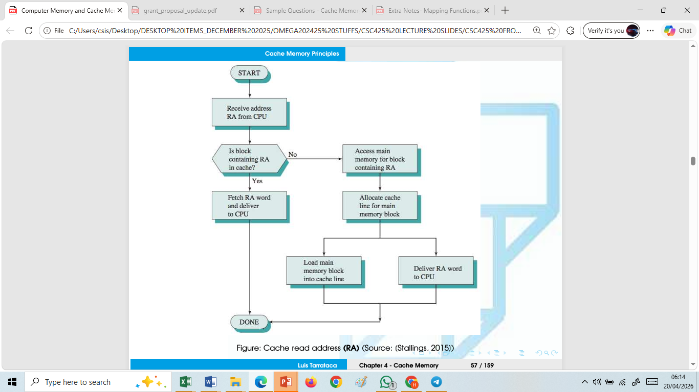
Cache Read Operation

Slide 28
Cache Read Operation
Processor generates read address (RA) of word to be read;
If the word ∈ cache, it is delivered to the processor;
Otherwise:
  Block containing that word is loaded into the cache;
  Word is delivered to the processor;
  These last two operations occurring in parallel

Slide 29
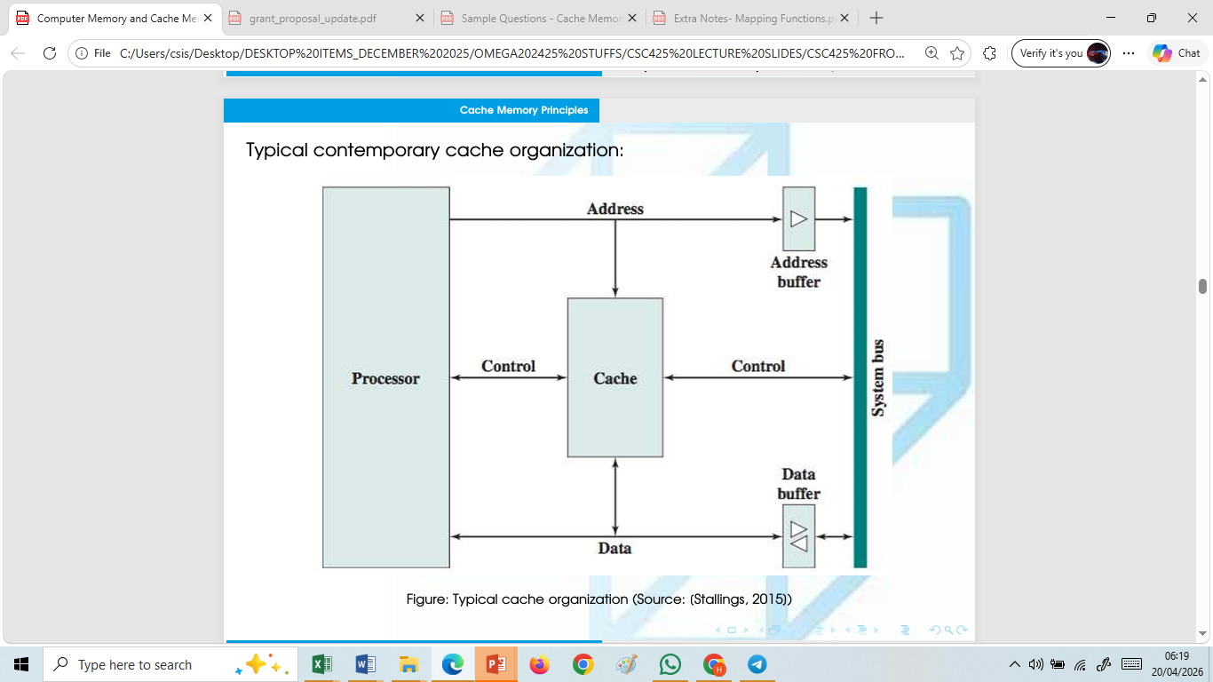
Typical Cache Organization

Slide 30
Explanation of Diagram
The cache:
Connects to the processor via data, control, and address lines;
Data and address lines also attach to data and address buffers:
Which attach to a system bus...
from which main memory is reached

Slide 31
What happens when a word is in Cache?
When a cache hit occurs (word is in cache):
the data and address buffers are disabled;
communication is only between processor and cache;
• no system bus traffic.

Slide 32
What happens when a word is NOT in Cache?
When a cache miss occurs (word is not in cache):
the desired address is loaded onto the system bus;
the data are returned through the data buffer...
...to both the cache and the processor

Slide 33
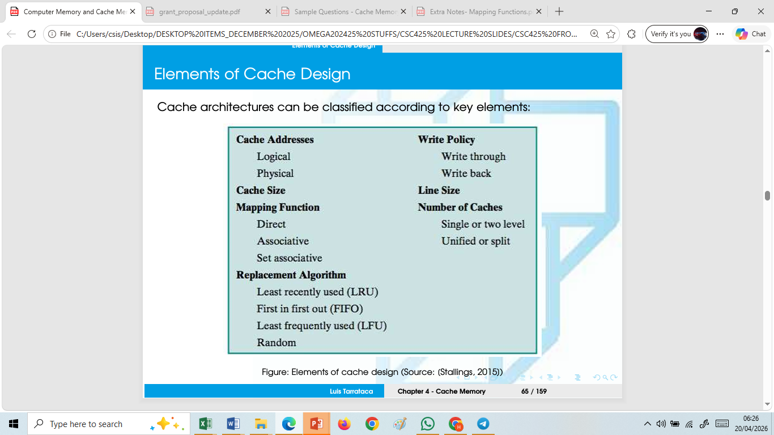
Elements of Cache Design

Slide 34
Cache Addresses
There are two types of cache addresses:
Physical addresses:
  Actual memory addresses;
Logical addresses:
  Virtual-memory addresses;

Slide 35
Cache Addresses
Virtual memory performs mapping between:
Logical addresses used by a program into physical addresses.
Why is this important?
Main idea behind virtual memory:
  Cache Addresses
  Disregard amount of main memory available;

Slide 36
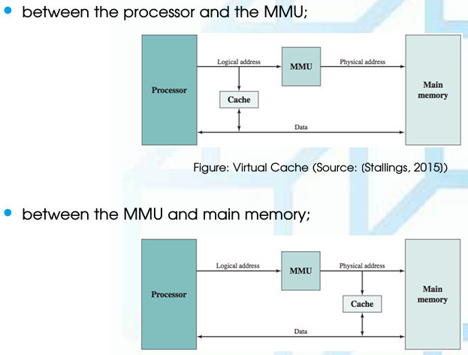
Cache Addresses
With virtual memory, cache may be placed

Slide 37
What is the difference?
Virtual cache stores data using logical addresses.
Processor accesses the cache directly, without going through the MMU.
Advantage:
  Faster access speed;
  Cache can respond without the need for an MMU address translation;
Disadvantage:
  Same virtual address in two different applications refers to two different
  physical addresses;
  Therefore cache must be flushed with each application context switch...
  ...or extra bits must be added to each cache line
to identify which virtual address space this address refers to

Slide 38
Cache Size
Cache size should be:
Small enough so that overall:
  Average cost per bit is close to that of main memory alone;
• Large enough so that the overall
  Average access time is close to that of the cache alone;
The larger the cache, the more complex the addressing logic:
  Result: large caches tend to be slightly slower than small ones
Available chip and board area also limits cache size.

Slide 39
Cache Mapping Functions
Recall that there are fewer cache lines than main memory blocks
How should one map main memory blocks into cache lines?
Three techniques can be used for mapping blocks into cache lines:
  Direct;
  Associative;
  Set associative

Slide 40
Direct Mapping Function
The simplest technique, known as direct mapping, maps each block of main memory into only one possible cache line.
The mapping is expressed as
i = j modulo m
where
i = cache line number
j = main memory block number
m = number of lines in the cache

Slide 41
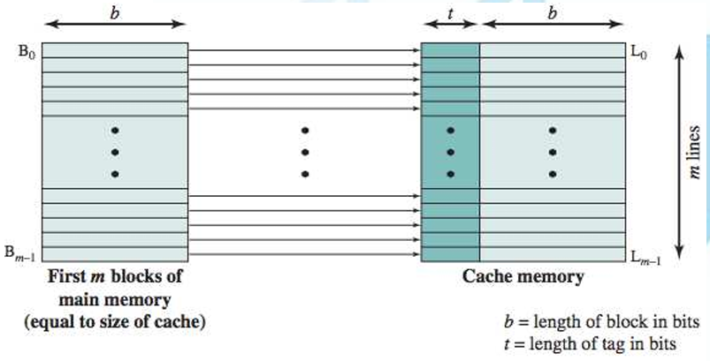
Direct Mapping Function

Slide 42
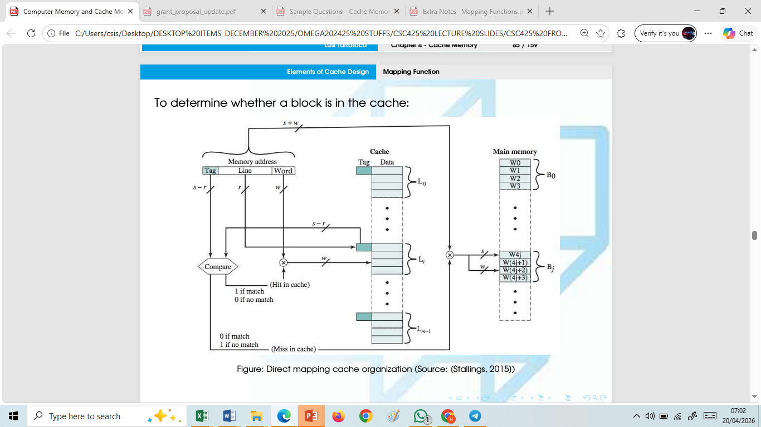
Direct Mapping Function

Slide 43
To determine whether a block is in the cache:
Use the line field of the memory address to index the cache line;
Compare the tag from the memory address with the line tag;
  If both match, then Cache Hit:
    Use the line field of the memory address to index the cache line;
    Retrieve the corresponding word from the cache line;
If both do not match, then Cache Miss:
  Use the line field of the memory address to index the cache line;
  Update the cache line (word + tag);

Slide 44
Direct Mapping Function
• Advantage: simple and inexpensive to implement;
• Disadvantage: there is a fixed cache location for any given block;
  • if a program happens to reference words repeatedly from two different blocks that map into the same line;
  • then the blocks will be continually swapped in the cache;
  • hit ratio will be low (a.k.a. thrashing).

Slide 45
Worked Examples on Direct Mapping Function
1. Consider a direct mapped cache of size 16 KB with block size 256 bytes. The size of main memory is 128 KB. Find-
  Number of bits in tag
  Tag directory size
Solution-
Given-
  Cache memory size = 16 KB
  Block size = Frame size = Line size = 256 bytes
  Main memory size = 128 KB

Slide 46
Worked Examples on Direct Mapping Function
We consider that the memory is byte addressable.
Number of Bits in Physical Address-
We have,
Size of main memory
128 KB = 2¹⁷ bytes
Thus, Number of bits in physical address = 17 bits
Number of Bits in Block Offset-
We have,
Block size = 256 bytes = 2⁸ bytes
Thus, Number of bits in block offset = 8 bits

Slide 47
Worked Examples on Direct Mapping Function
Thus, Number of bits in block offset = 8 bits
Number of Bits in Line Number-
Total number of lines in cache= Cache size / Line size
= 16 KB/256 bytes
= 2¹⁴ bytes / 2⁸ bytes= 2⁶ lines
Thus, Number of bits in line number = 6 bits

Slide 48
Worked Examples on Direct Mapping Function
Number of Bits in Tag-
= Number of bits in physical address – (Number of bits in line number + Number of bits in block offset)
= 17 bits –(6 bits + 8 bits)
= 17 bits –14 bits = 3 bits
Thus, Number of bits in tag = 3 bits

Slide 49
Worked Examples on Direct Mapping Function
Tag Directory Size-
Tag directory size
= Number of tags x Tag size = Number of lines in cache x Number of bits in tag
= 2⁶x 3 bits = 192 bits = 24 bytes
Thus, size of tag directory = 24 bytes

Slide 50
Associative Mapping
Associative mapping overcomes the disadvantage of direct mapping by permitting each main memory block to be loaded into any line of the cache (Figure 4.8b).
In this case, the cache control logic interprets a memory address simply as a Tag and a Word field.
The Tag field uniquely identifies a block of main memory. To determine whether a block is in the cache, the cache control logic must simultaneously examine every line’s tag for a match.

Slide 51
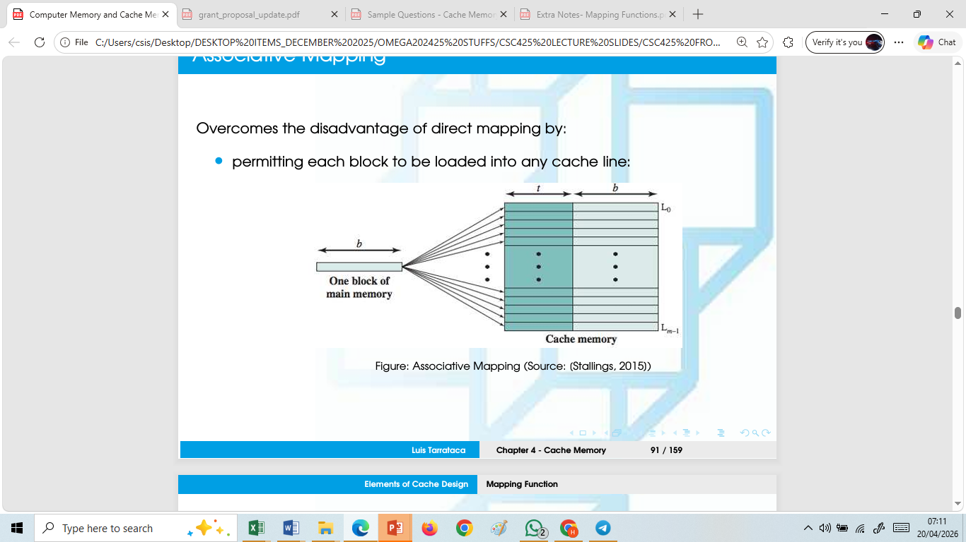
Associative Mapping

Slide 52
Associative Mapping
Cache interprets a memory address as a Tag and a Word field:
Tag: (s bits) uniquely identifies a block of main memory;
Word: (w bits) uniquely identifies a word within a block;

Slide 53
To determine whether a block is in the cache
simultaneously compare every line’s tag for a match:
If a match exists, then Cache Hit:
  Use the tag field of the memory address to index the cache line;
  Retrieve the corresponding word from the cache line;
If a match does not exist, then Cache Miss:
  Choose a cache line. How?
  Update the cache line (word + tag);

Slide 54
Worked Examples on Associative Mapping
Example 1:
Consider a fully associative mapped cache of size 16 KB with block size 256 bytes. The size of main memory is 128 KB. Find-
1.Number of bits in tag
2.Tag directory size
Solution-
Given-
- Cache memory size = 16 KB
- Block size = Frame size = Line size = 256 bytes
- Main memory size = 128 KB

Slide 55
Worked Examples on Associative Mapping
We consider that the memory is byte addressable.
Number of Bits in Physical Address-
We have,
Size of main memory
= 128 KB
= 2¹⁷bytes
Thus, Number of bits in physical address = 17 bits
Number of Bits in Block Offset-
We have Block size
= 256 bytes
= 2⁸ bytes

Slide 56
Worked Examples on Associative Mapping
Thus, Number of bits in block offset = 8 bits
Number of bits in tag
= Number of bits in physical address –Number of bits in block offset
= 17 bits –8 bits = 9 bits
Thus, Number of bits in tag = 9 bits
Number of Lines in Cache-
Total number of lines in cache
= Cache size / Line size
= 16 KB / 256 bytes
= 2¹⁴bytes / 2⁸bytes = 2⁶ lines

Slide 57
Worked Examples on Associative Mapping
Tag directory size
= Number of tags x Tag size
= Number of lines in cache x Number of bits in tag
= 2⁶ x 9 bits
= 576 bits= 72 bytes
Thus, size of tag directory = 72 bytes

Slide 58
Worked Examples on Associative Mapping
Example 2:
Consider a fully associative mapped cache with block size 4 KB. The size of main memory is 16 GB. Find the number of bits in tag.
Given-
- Block size = Frame size = Line size = 4 KB
- Size of main memory = 16 GB
We consider that the memory is byte addressable.
Number of Bits in Physical Address-
We have,
Size of main memory
= 16 GB
= 2³⁴ bytes

Slide 59
Worked Examples on Associative Mapping
Thus, Number of bits in physical address = 34 bits
Number of Bits in Block Offset-
We have,
Block size
= 4 KB = 2¹² bytes
Thus, Number of bits in block offset = 12 bits
Number of Bits in Tag-
= Number of bits in physical address – Number of bits in block offset
= 34 bits – 12 bits = 22 bits
Thus, Number of bits in tag = 22 bits

Slide 60
Worked Examples on Associative Mapping
Thus, Number of bits in physical address = 34 bits
Number of Bits in Block Offset-
We have,
Block size
= 4 KB = 2¹² bytes
Thus, Number of bits in block offset = 12 bits
Number of Bits in Tag-
= Number of bits in physical address – Number of bits in block offset
= 34 bits – 12 bits = 22 bits
Thus, Number of bits in tag = 22 bits

Slide 61
Set associative mapping
This form of mapping is an enhanced form of direct mapping where the drawbacks of direct mapping are removed.
Set associative addresses the problem of possible thrashing in the direct mapping method.
It does this by saying that instead of having exactly one line that a block can map to in the cache, we will group a few lines together creating a set.
Then a block in memory can map to any one of the lines of a specific set. Set-associative mapping allows that each word that is present in the cache can have two or more words in the main memory for the same index address.
Set associative cache mapping combines the best of direct and associative cache mapping techniques.

Slide 62
Worked Examples on Set-Associative Mapping
Example 1:
Consider a 2-way set associative mapped cache of size 16 KB with block size 256 bytes. The size of main memory is 128 KB. Find-
1. Number of bits in tag
2. Tag directory size
Given-
- Set size = 2
- Cache memory size = 16 KB
- Block size = Frame size = Line size = 256 bytes
-Main memory size = 128 KB

Slide 63
Worked Examples on Set-Associative Mapping
We consider that the memory is byte addressable.
Number of Bits in Physical Address-
We have,
Size of main memory = 128 KB= 2¹⁷ bytes
Thus, Number of bits in physical address = 17 bits
Number of Bits in Block Offset-
We have,
Block size = 256 bytes= 2⁸bytes
Thus, Number of bits in block offset = 8 bits

Slide 64
Worked Examples on Set-Associative Mapping
Number of Lines in Cache-
Total number of lines in cache = Cache size / Line size
= 16 KB / 256 bytes
= 2¹⁴ bytes / 2⁸ bytes= 64 lines
Thus, Number of lines in cache = 64 lines
Number of Sets in Cache-
Total number of sets in cache
= Total number of lines in cache / Set size
= 64 /2= 32 sets
= 2⁵ sets
Thus, Number of bits in set number = 5 bits

Slide 65
End of Lesson 3

